Slide 1
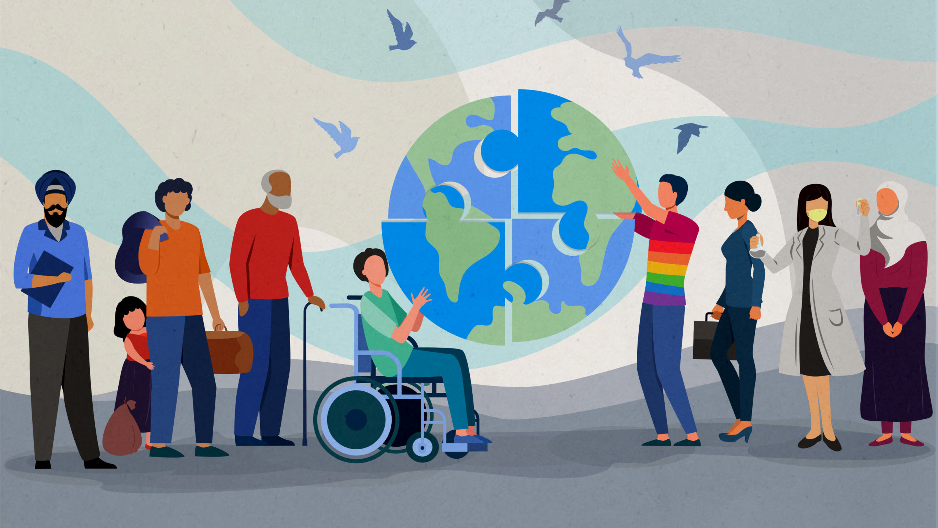
Forget About Diversity!

Slide 2
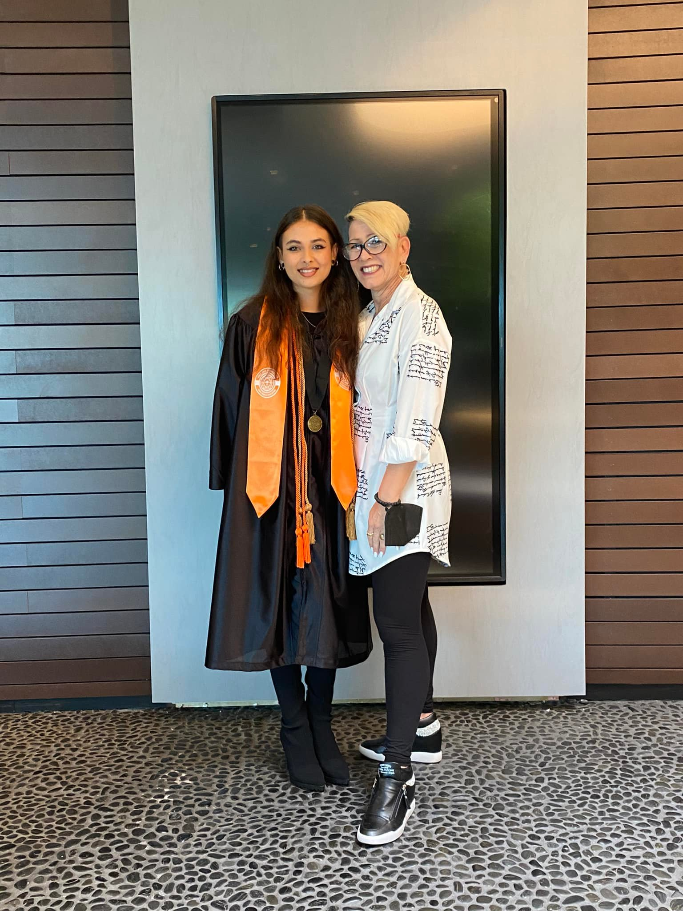


Sandy Zannino SPHR, SHRM-SCP, IICPD, DCOP
HR Compliance Audits
On Demand HR Director
Profit Protection Training
DEI Consulting & Training
Recruiting
Executive Advisory Board WOCAN—Ally Chair
sandy@innovativeautohr.com 941-306-8310

Slide 3
Forget About Diversity!
Let’s Talk About Inclusion

Slide 4
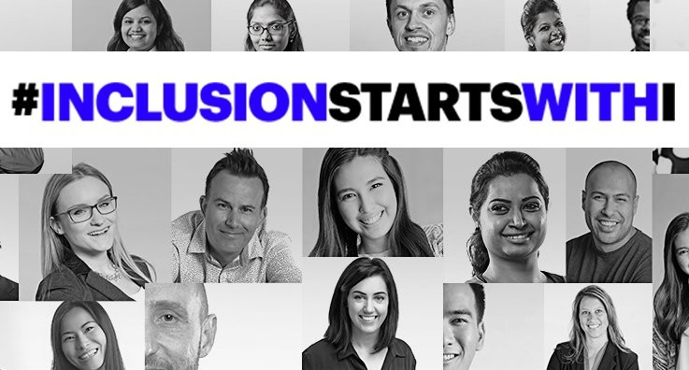

Slide 5
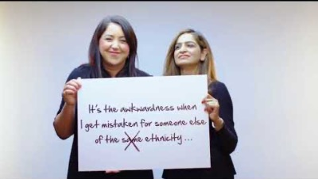

Slide 6

Will you join me in this conversation today?
This Photo by Unknown Author is licensed under CC BY-SA-NC

Slide 7
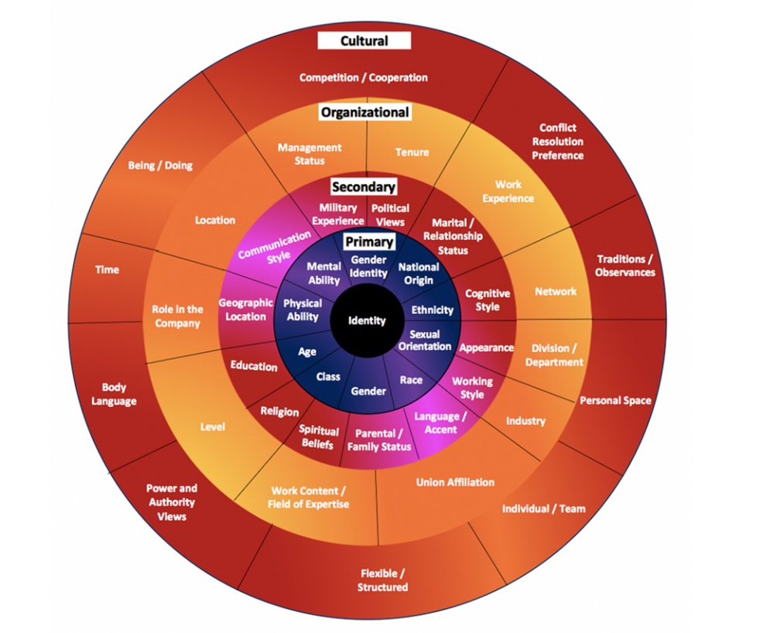

Slide 8
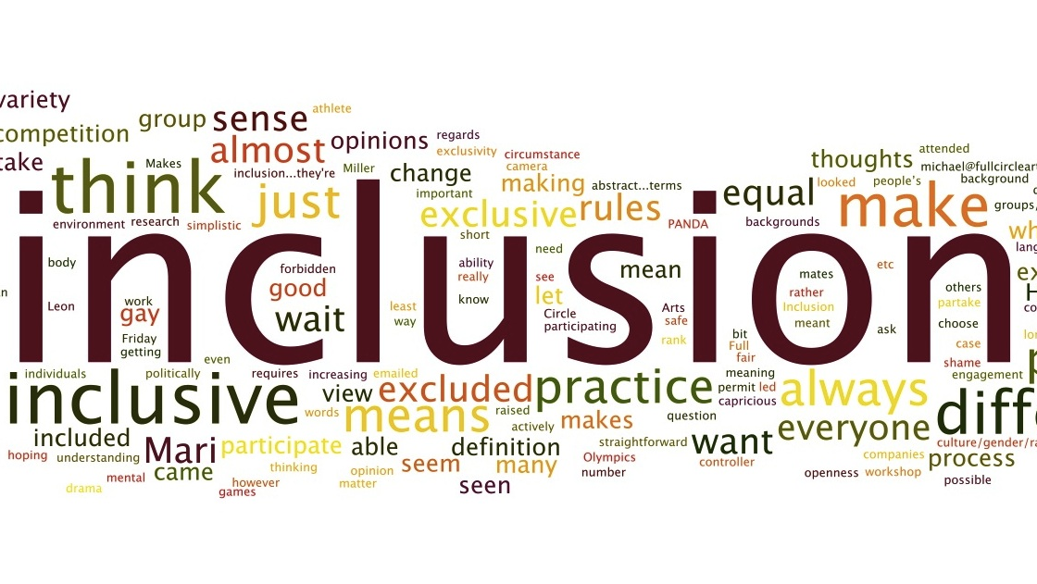
This Photo by Unknown Author is licensed under CC BY-SA-NC

Slide 9

This Photo by Unknown Author is licensed under CC BY-SA

Slide 10

This Photo by Unknown Author is licensed under CC BY

Slide 11

This Photo by Unknown Author is licensed under CC BY-SA-NC

Slide 12

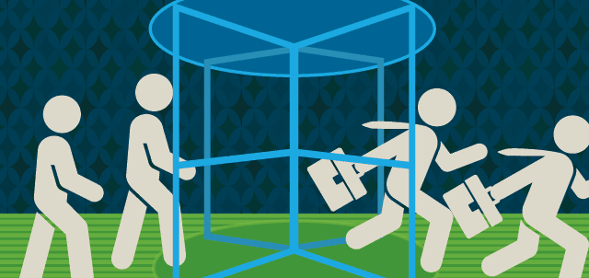
This Photo by Unknown Author is licensed under CC BY-NC

Slide 13
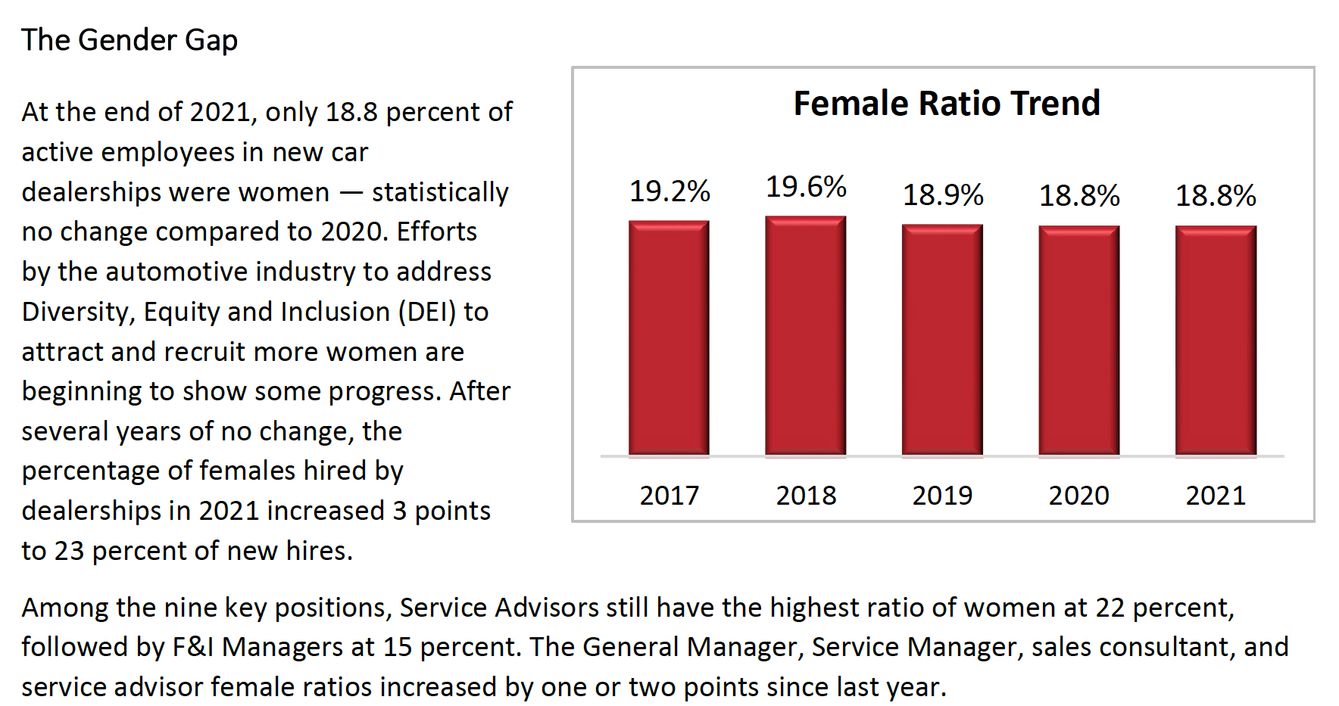

Slide 14
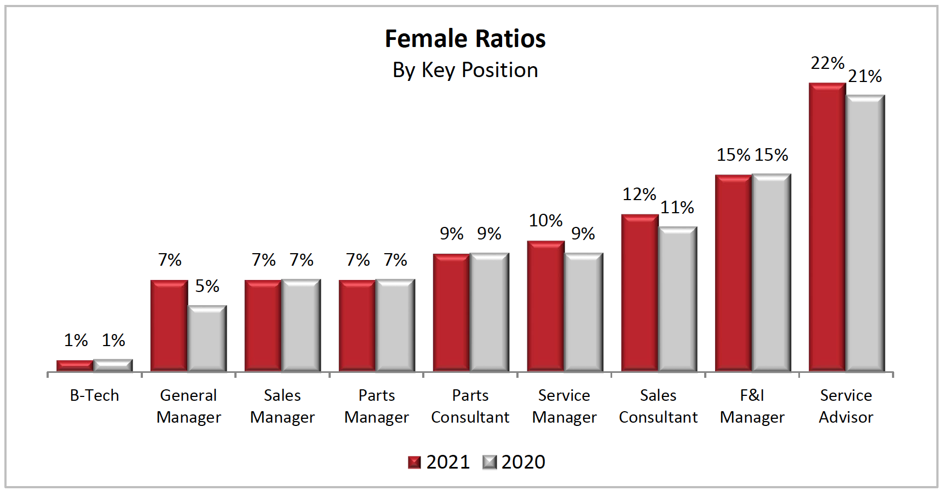

Slide 15
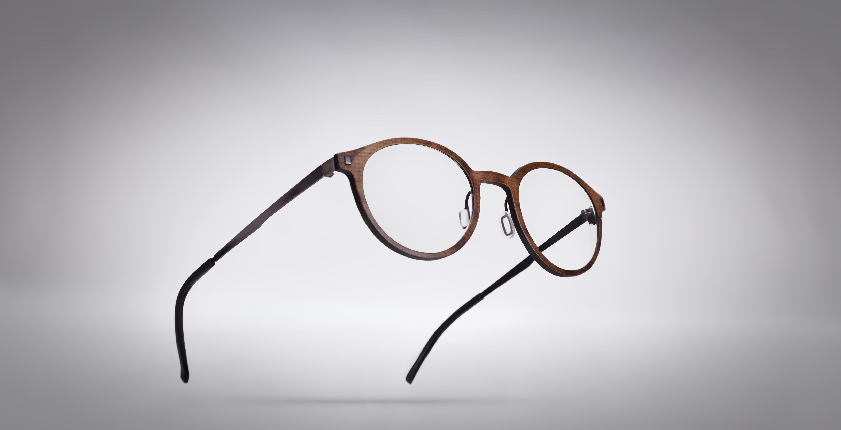

Slide 16
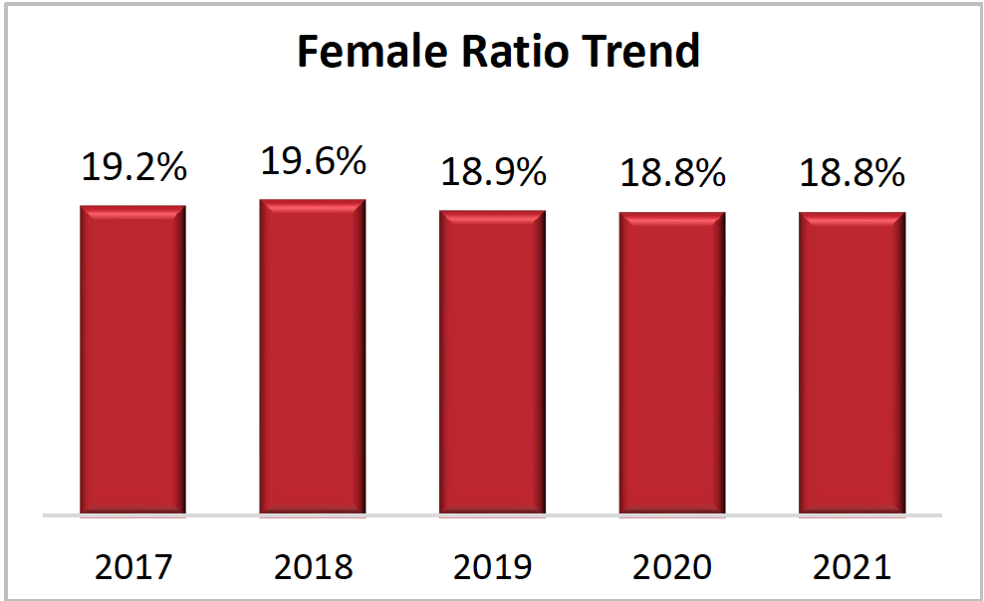

Slide 17
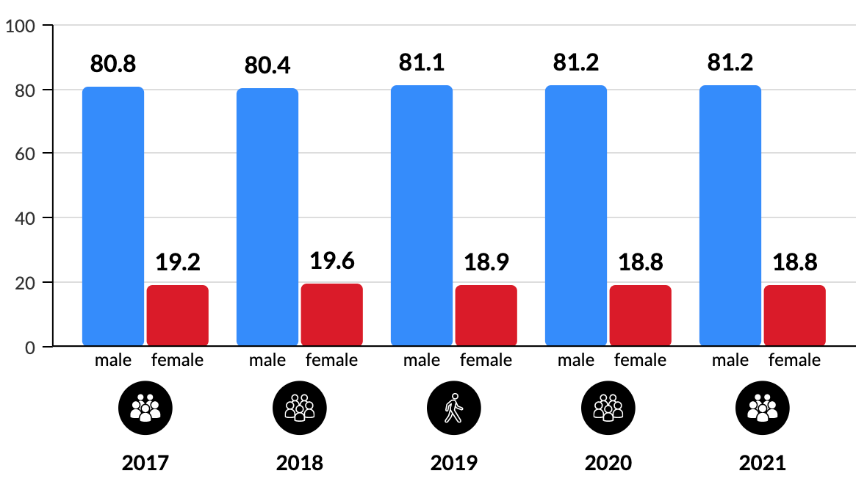
Male & Female Ratio

Slide 19
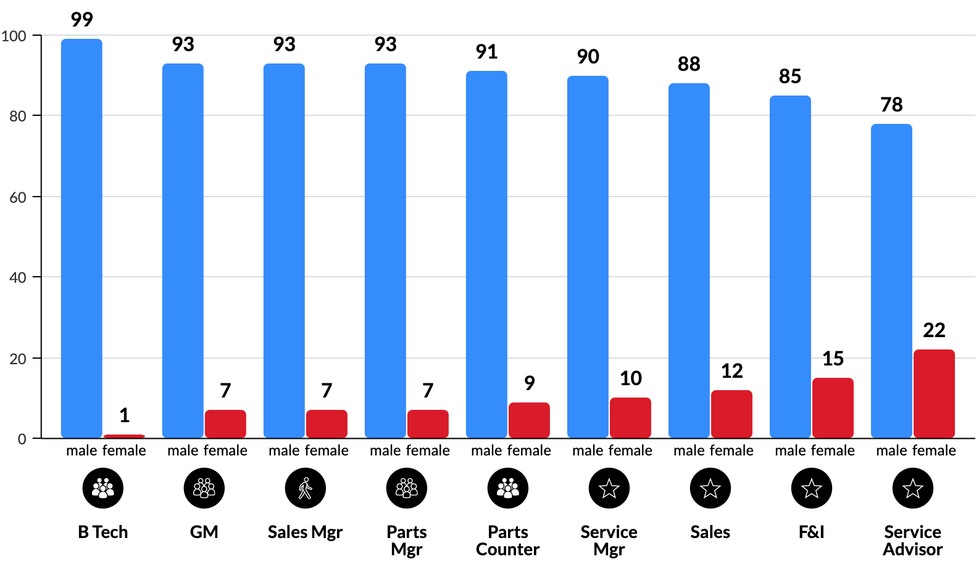

Slide 20

Ability to Attract Talent
Turnover
Gender Gap

Slide 21
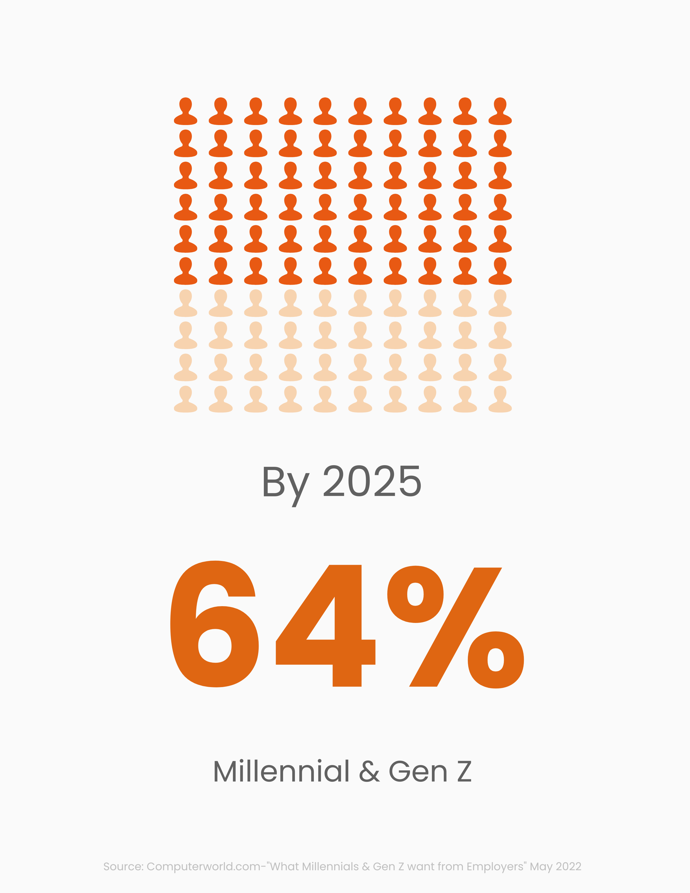
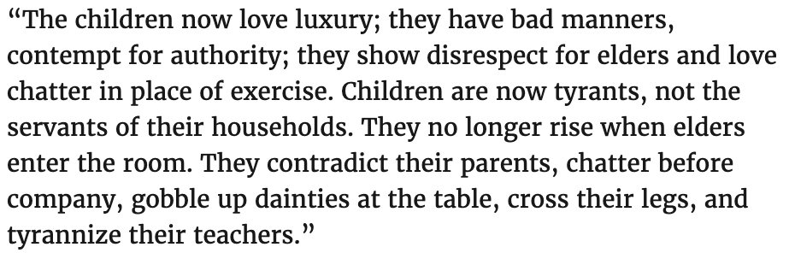
-SOCRATES

Slide 22


Slide 23

Millennials (1981-1996)
Passion
Technology. 9/11, terrorism, school shootings, Y2K, laptops/cell phones. Social media
Internet
Creativity, collaboration, diversity, inclusion, authenticity, purpose, open mindedness, passion for issues
Anything that expresses individual style
Work should have meaning & align with purpose
To connect: Communicate expectations, feedback, genuine relationships, connect with cause, allow creativity, mentoring, coaching, teamwork. (text don’t call)

Slide 24

Gen Z (1997-2010)
Practical
Post 9/11 fear, Great Recession, smartphones, tablets, mass shootings, polarized society
Social media platforms
Practicality, equality, inclusion, innovation, integration
Open to what company requires AND fits their personal brand
Work hard, job security, personal brand & side hustle
To connect: Authentic, genuine interest, empathy, technology—digital tools, Embrace “yes-and”, show them tangible outcomes—Face to Face Conversation!

Slide 25
Millennial
Gen Z
18.8% Hispanic
14.2% Black/African American
4.3% Asian
3.2% Mixed/Other
59.8% White
25% Hispanic
13.8 % Black/African American
5.3% Asian
50.9% White
29% Children of Immigrants or immigrants

Slide 26


Slide 27
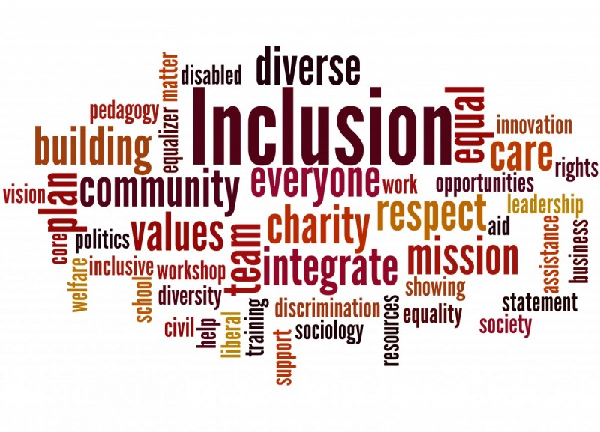
What IS Inclusion?
The extent to which diverse groups have a seat at the table and are able to bring their best contributions
Dependent on one’s perception of being valued AND fitting in even with differences
Collaborative, Supportive & Respectful
This Photo by Unknown Author is licensed under CC BY-NC

Slide 28

What inclusion
is NOT
Conforming to the cultural and social norms of the majority
GOOD FIT?

Slide 29
What do I do to GET an Inclusive Culture???

Slide 31

Inclusive Leader
4 Essential Skills to Develop

Slide 32

Open Minded Awareness
Courage to Challenge yourself & bias’
Committed to learning
Contempt prior to investigation (don’t have it)
Comfortable being uncomfortable
Becoming Self Aware
Humility & Patience
Valuing Differences

Slide 33
Emotional Intelligence
Continued learning & Self Examination
Cultivating Empathy
Active Listening Skills
Intentionally notice bias
  Example: Single parent candidate—Belief that they will be unable to meet the sales schedule
Self Regulation
  Put the I over the E
  Feelings are not Facts

Slide 34
Emotional
Maturity
Committed to Continued Learning
Beliefs, Words & Actions align (Integrity)
  Say what you mean, mean what you say -- & don’t be mean
Collaboration with others
Communication & sharing with those you lead
Accountability
Actively checking yourself & bias when it comes up
  And it will ☺

Slide 35
Cultural Intelligence
CURIOSITY
Continued learning
Cultivate Empathy
  Honoring others lived experience even if it’s not yours
Discovering your team
Sharing your own experience—Makes it safe for others
Builds trust

Slide 36
4 Essentials
Open Mindedness & Self Awareness
Emotional Intelligence
Emotional Maturity
Cultural Intelligence

Slide 38
Forget About Diversity!
Let’s Talk About Inclusion

Slide 39

THANK YOU!
Sandy Zannino
sandy@innovativeautohr.com
941-306-8310

Slide 40
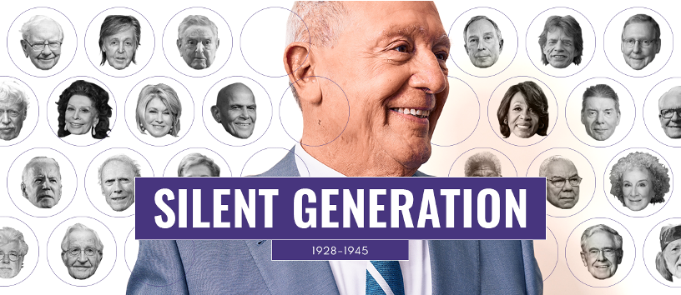
Silent Generation (Traditionalists) 1928-1945
Steady
Hard Times. Great Depression. WWII, Korean War.
Radio
Loyalty, patriotism, duty first, respect for authority
Suit/tie. Skirt suit & hose (IF women joined workforce). Chain of command
Work is an opportunity. Hard work will bring rewards over time
To Connect: Respect their authority, ask them about their life, get them to tell their stories, formal and good grammar in writing!

Slide 41
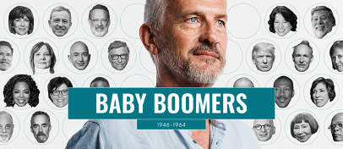
Boomers (1946-1964)
Ambition
Big Societal Changes. Moon, Civil Rights, JFK, Vietnam, Woodstock, feminism.
TV
Ambition, hard work, American Dream, Change the world
Suit, collared shirt, skirt/blouse
Work hard, pay dues, ladder, dedication is path to success
To connect: Build rapport, respect experiences, say “thank you”, courteous & structured communication, L&D

Slide 42
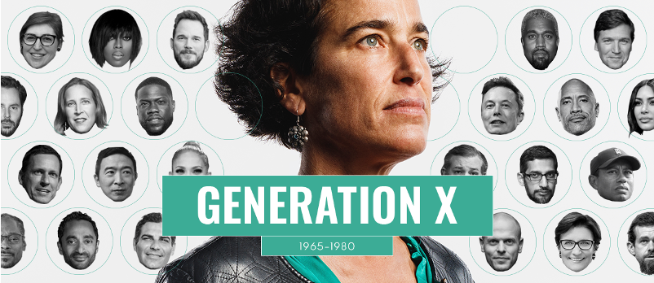
Generation X (1965-1980)
Balance
Change is constant. Latchkey, Berlin Wall, Desert Storm, Challenger, HIV/AIDS, personal computers
TV & early internet
Flexibility, work-life balance, skepticism, independence
Business casual
Work smarter not harder, no micromanaging, work can be done anywhere.
To connect: Be open, honest, transparent. Promote work/life balance, mentoring, independence.

