Slide 1
Creating a Dealership UDAP/UDAAP Prevention Policy and Guidelines
Eric Johnson and Andrea Cottrell, Hudson Cook, LLP

Slide 2
Disclaimer
This presentation is provided for informational purposes only. The presentation is not intended to be an exhaustive review of all laws on any subject. We have made every effort to ensure that the information in this presentation is complete and accurate with respect to the topic(s) addressed. Hudson Cook, LLP and the individual presenter(s) are not responsible for any errors in or omissions from the information provided.
Nothing in this presentation should be construed as legal advice from Hudson Cook, LLP or the individual presenter, nor is the presentation a substitute for legal counsel on any matter. Legal advice must be tailored to specific facts and circumstances. No attendee of this presentation should act or refrain from acting solely on the basis of any information included in this presentation. Attendees should seek appropriate legal or other professional advice on legal matters specific to their business.
The views and opinions in this presentation are those of the presenter and do not necessarily represent official policy or position of Hudson Cook, LLP or of its clients.

Slide 3
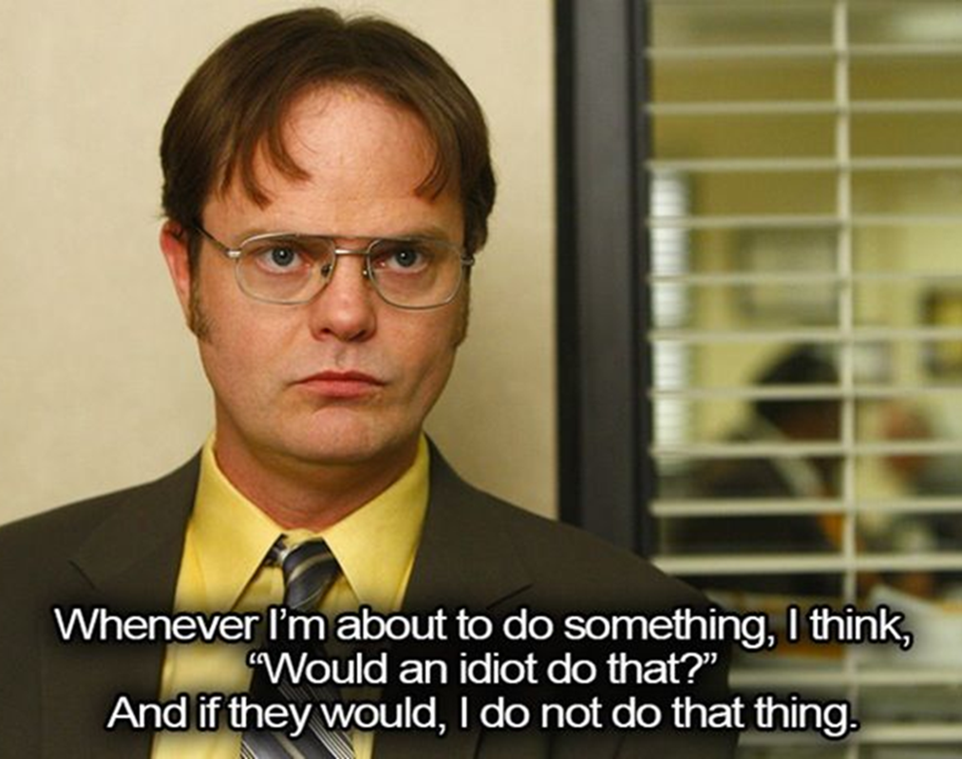

Slide 4
What’s a policy?
A policy considers the laws and regulations applicable to the dealership. It outlines the specific laws/regs/guidance the dealership strives to comply with in a specific area.
  Ethics, risk tolerance and compliance are built into all policies and procedures.
  Policies should be concise and in plain English.
  Procedures implement policies and are specific to different positions and management levels in the organization.
  A Policy says, “this is the law we are going to follow.” A Procedure says, “this is how we are going to follow the law we promised to follow in the policy.”

Slide 5
Why do we need one?
Formal polices outline a dealership’s compliance requirements and allow a dealership to “prove” its culture of compliance.
Policies set up a dealership to:
  Prevent and Detect Compliance Issues
  Gain Knowledge at Every Level
  Communicate Regularly About Compliance
  Evaluate and Test for Compliance
  Incentivize and Discipline
  Provide Timely Responses to Requests for Information

Slide 6
FTC – Prohibition of UDAPs
Section 5 of the Federal Trade Commission Act (FTC Act), enacted in 1938, prohibits “unfair or deceptive acts or practices in or affecting commerce.”
An act or practice may be found to be both unfair and deceptive, but an agency may bring a Section 5 enforcement action if it deems the act or practice to be either unfair or deceptive.
Historically, the majority of FTC advertising enforcement actions have been brought under the “deceptive” prong because the standard of proof is a better fit than “unfairness.”

Slide 7
CFPB – Prohibition of UDAAPs
Under the Dodd-Frank Act, the CFPB is authorized to take any action to prevent companies within its jurisdiction from engaging in “unfair, deceptive, or abusive acts or practices” or “UDAAPs”.
The CFPB has actively pursued UDAAP cases against both large and small consumer financial services companies.
Most of the CFPB’s public enforcement actions have involved one or more UDAAP allegations.

Slide 8
UDA(A)P standards
The principles of “unfair” and “deceptive” practices in the Dodd Frank Act are informed by the standards for the same terms under Section 5 of the FTC Act.
In the past, the CFPB indicated that FTC guidance and authority reflect the views of the FTC, and are not binding upon the Bureau in interpreting the Dodd-Frank Act’s prohibition on UDAAPs.
However, the two agencies are enforcing the same standards.
Thus, it has always been important to stay aware of both FTC and CFPB developments regarding UDA(A)Ps.

Slide 9
Unfair standard
An act or practice is unfair when:
It causes or is likely to cause substantial injury to consumers;
The injury is not reasonably avoidable by consumers; and
The injury is not outweighed by countervailing benefits to consumers or to competition.

Slide 10
deceptive standard
A practice is deceptive if:
A representation, omission, act, or practice misleads or is likely to mislead the consumer;
A consumer’s interpretation of the representation, omission, act, or practice is reasonable under the circumstances; and
The misleading representation, omission, act, or practice is material.

Slide 11
CFPB - Abusive standard
To declare act/practice “abusive,” CFPB must find that the act or practice:
materially interferes with consumer’s ability to understand a term or condition; or
takes unreasonable advantage of:
  the consumer’s lack of understanding of material risks, costs, or conditions of the product or service;
  the consumer’s inability to protect his or her interests in selecting or using financial product or service; or
  the consumer’s reasonable reliance on provider to act in consumer’s interest.

Slide 12
State specific udap standards
At the state level, many states itemize a list of prohibited UDAP practices, unlike the federal standard.
Also, some states offer a private right of action to injured consumers, unlike federal.
Some may provide for treble damages too.

Slide 13
POLICY structure
Proposed Structure for a Policy:
I. PURPOSE OF THE UDAP/UDAAP POLICY
II. SUMMARY OF LAW
III. BUSINESS ACTIVITIES IMPACTED
IV. BUSINESS OVERVIEW
RESPONSIBILITY FOR POLICY
UDAP/UDAAP PREVENTION POLICY
A. POLICIES, GUIDELINES AND PROCESSES IMPACTING UDAP/UDAAP PREVENTION
Unfairness
  Cause or Likely to Cause Substantial Injury to Consumers
  Injury Not Reasonable Avoidable by Consumers
  Injury Not Outweighed by Offsetting Benefits to Consumers or to Competition
  Unfairness Examples

Slide 14
POLICY structure (cont’d)
Proposed Structure for a Policy (cont’d):
2. Deception
Representation, Omission or Practice that Misleads or is Likely to Mislead
A Reasonable Consumer
Representation, Omission or Practice Must be Material
Deception Examples
3. Abusive
Materially Interferes with the Ability of Consumer to Understand a Term or Condition of a Consumer Financial Product or Service; or
Takes Unreasonable Advantage of:
  Lack of understanding on part of the consumer of the material risks, costs or conditions of the product or service
  Inability of the consumer to protect the interests of the consumer in selecting or using a consumer financial product or service; or
  Reasonable reliance by consumer on a covered person to act in the consumer’s interests

Slide 15
POLICY structure (cont’d)
Proposed Structure for a Policy (cont’d):
c) Abusive Examples
UDAAP and Other Laws
Compliance Considerations
B. TRAINING
C. RECORDKEEPING
VII. REVIEW AND REVISION HISTORY
A. PERIODIC REVIEW OF POLICY
B. AUDIT
C. REVISION HISTORY

Slide 16
guidance
FTC Enforcement Actions
CFPB Bulletins, Circulars, Advisory Opinions, etc.
CFPB UDAAP Exam Procedures
  Definitions and standards for UDAAPs
  Examples from federal enforcement actions
  Discusses role of consumer complaints in identifying UDAAPs
  Discusses relationship to other laws
  Outlines Examination Objectives, Steps & Procedures
CFPB Enforcement Actions
CFPB Supervisory Highlights

Slide 17


Slide 18




Contact information
Eric Johnson
Hudson Cook, LLP
918 S.W. 107th St.
Suite 200
Oklahoma City, OK 73170
405.602.3812
405.590.9920
 ejohnson@hudco.com
linkedin.com/in/eric-johnson-consumer-financial-services-attorney
Andrea Cottrell
Hudson Cook, LLP
12650 N Beach Street
Suite 114, #7058
Fort Worth, TX 76244
682.540.2116
682-540-2116
 acottrell@hudco.com
https://www.linkedin.com/in/andrea-s-cottrell-55b4328/
Follow Hudson Cook

