Slide 1
The Three Components of Leadership
Doing The Right Things – The Right Way – In The Right Order

Slide 2

Great Dealerships Like Great Companies Think And Act Differently!
Great dealerships identify something larger than transactions to provide purpose and meaning.
Great dealerships follow the three leadership principles of success that have built some of the strongest companies in the USA.
Dealer groups that have emerged as leaders in the industry have left clues of what got them to the top.
Do Right Things - Right Way - In The Right Order!

Slide 3

Dealerships That Lead Are Doing The Right Things
Transparency Leads To Transformation
Lead With Listening
Process Conveys Clarity Of Message

Slide 4
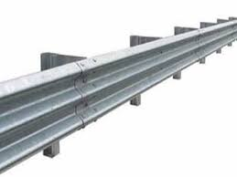
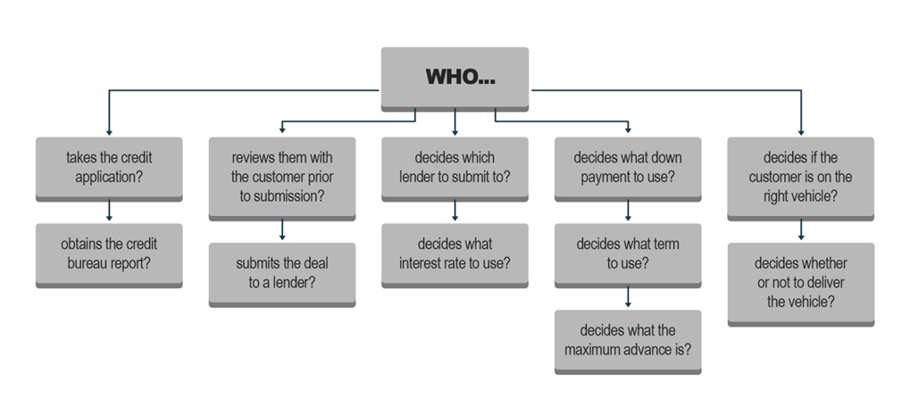
Doing The Right Things
Guardrails Establish Guidance Develop a Process With a Plan!

Slide 5
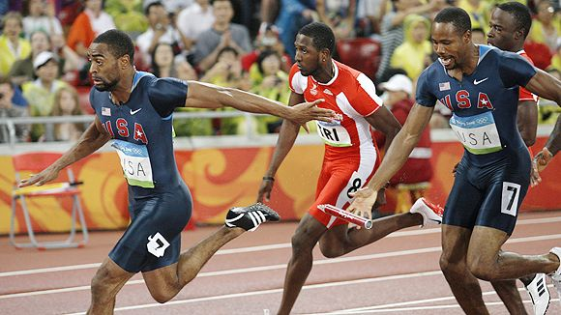
Doing The Right Things
Compliance Culture Creates Success
Seamless Team Integration
F&I Involved Early
Quotes Come Clearly

Slide 6

The Right Way
Develop And Invest In The Team
Reinforce And Record
Review To Rise
Create The Culture Reap The Benefits!
What happens if we develop our people and they leave us? What happens if we don’t develop our people and they stay?

Slide 7

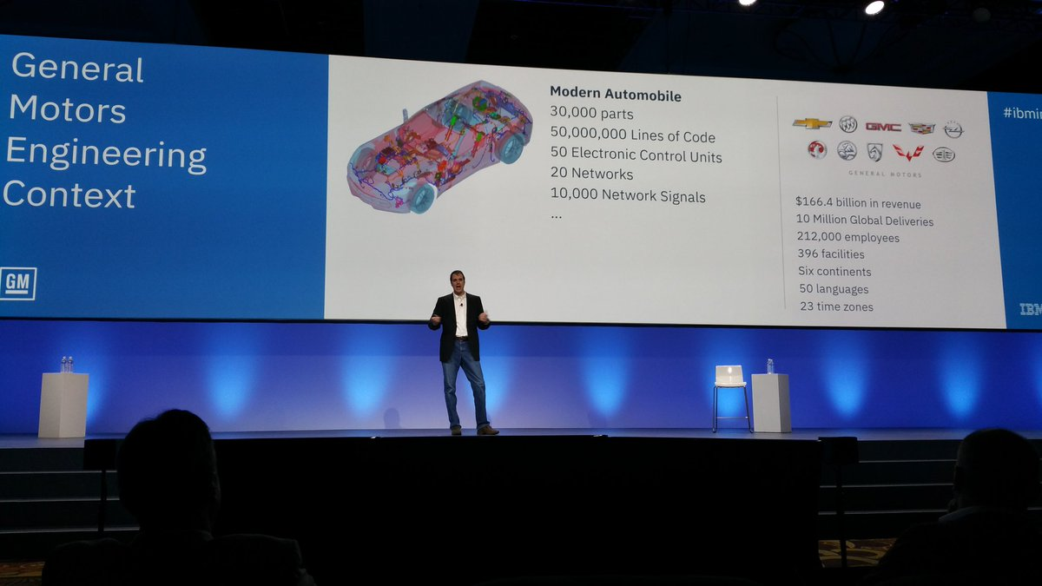
The Right Way
Growth Is Expected In All Areas
Value Building Abilities

Slide 8

The Right Way - In The Showroom
All Managers Hands On!
Accurate And Transparent Payments – Communicated Clearly
Clean Handoff From Sales To F&I
Eliminate The Wait!

Slide 9
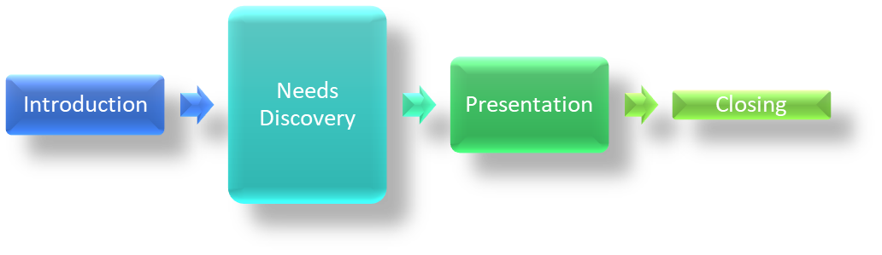
The Right Way - In The F&I Office
F&I Product Focused Presentation Leads To Frustration!
Introduction
Presentation
Closing
Needs
Discovery
F&I Customer Focused Presentation Leads To Satisfaction!

Slide 10
The Right Order
The Most Important Thing In Business Is To Know What Is The Most Import Thing In Business
1 - Help Customers!
2- Safe Guard The Dealership
3- Make A Profit
4 - Secure The Deal

Slide 11
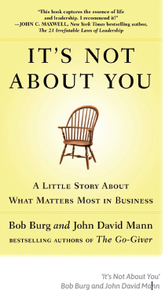
The Right Order – Help Customers
Remember, it’s not about you.
It’s not about what you want, it’s about what the customer needs.
Hold the Vision
Lesson #1:
The hard part isn’t coming up with the vision, it’s holding on to the vision.
Lesson #2:
Your influence is determined by how abundantly you place other people’s interests first.
Lesson #3:
Be Humble, stay grounded, and work at your craft.
Build your people
Do the Work
Customer First Process

Slide 12
The Right Order – Help Customers
Stand for Something
Lesson #4:
People need to trust your competence, but they need to trust your character more.
Lesson #5:
It’s not about you, it’s about them. Don’t start thinking you’re the deal.
Share the Mantle
When You Focus On The Customer - You Will Never Harm Them!
Customer First Process

Slide 13
The Right Order – Safe-Guard The Dealership
Red Flag Rule
UDAAP Laws
Adverse Action Notice
Truth In –Lending Act
Equal Credit Opportunity
US Patriot Act
Rick Based Pricing Rule
Cash Reporting Rule
Safeguards Rule
Fair Credit Reporting
And More!

Slide 14
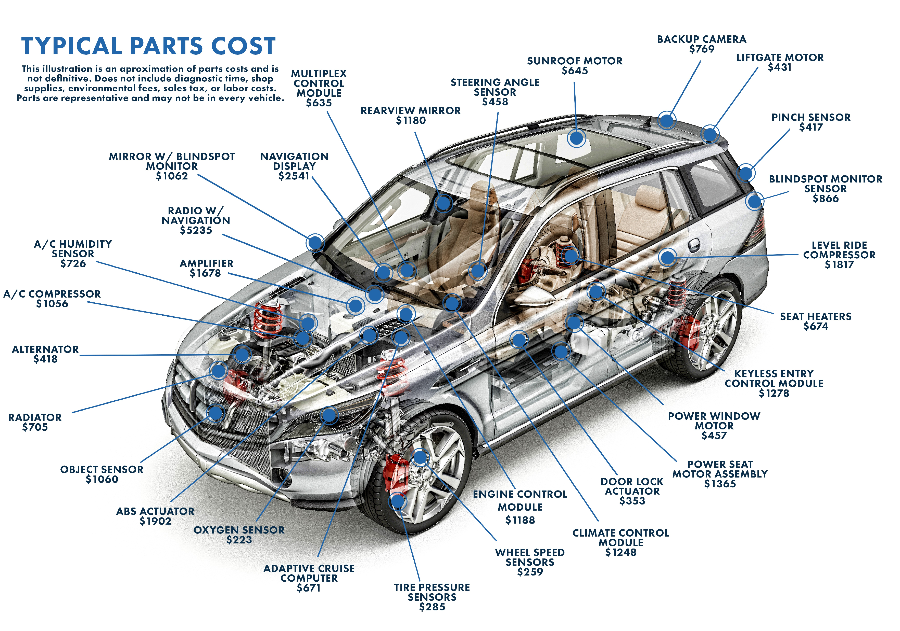
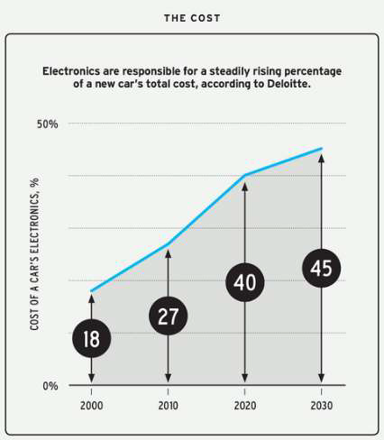
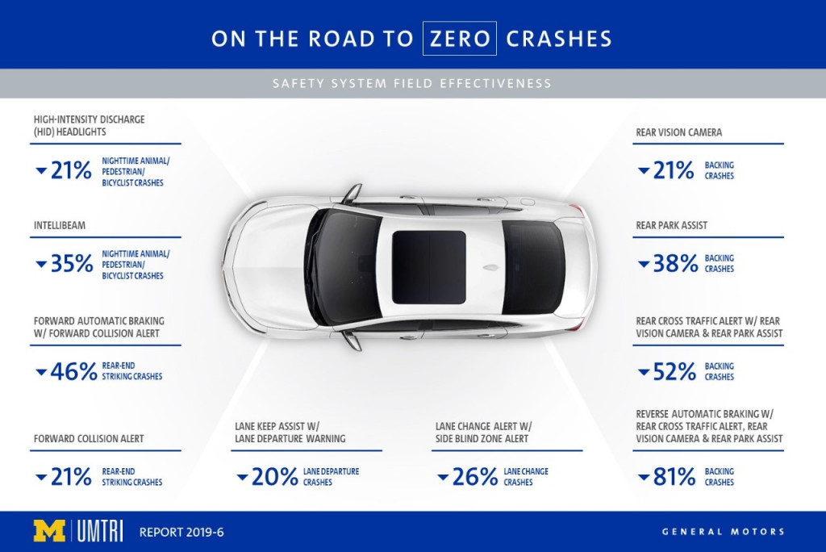
The Right Order – Make A Profit
Know The Products
Passionate About Products – Have Proof
Find And Fill Customers Needs

Slide 15

The Right Order – Secure The Deal
F&I Responsibilities – Beyond The Deal
Lenders - Fenders And Fraud
Clarification – Verification Leads To Vindication!

Slide 16
Theme copy | Theme Copy | Theme Copy
Thank You For Your Time

