Slide 1
Don’t Be Afraid To Flex
M. Ritchey Wheeler, President
Eagle Training Academy

Slide 2
Understand the Position
As the dealership Compliance Officer, YOU are an important part of the Executive Leadership Team
You report (or should report) directly to the dealer principal
Dedicated CO vs. multi-role
Theme copy | Theme Copy | Theme Copy

Slide 3
Don’t Play Dealer
Your role is to conduct thorough analysis and provide clear comments
Understand your role within the dealership
The dealer will make the staffing decisions
The dealer will make the business decisions
Theme copy | Theme Copy | Theme Copy
Notes:
Cecil Story #1, Blake Story #4

Slide 4

Audits
Perform regular audits
Share those with the management team
For example: Save-A-Deal Meetings
Theme copy | Theme Copy | Theme Copy

Slide 5
W.I.I.F.M.
Don’t sell fear
Educate the staff on why they should care
What’s in it for them?
Theme copy | Theme Copy | Theme Copy

Slide 6
Leadership
Use your platform to gain respect for the mission and how it effects the dealership
Don’t miss opportunities (staff meetings)
Theme copy | Theme Copy | Theme Copy
Notes:
Escoto story #2

Slide 7
You didn’t win the Game on Sunday
You won the game Monday through Saturday
Exercise your leadership muscle
Be a servant leader
It’s not personal, it’s just business
Eat last
Theme copy | Theme Copy | Theme Copy

Slide 8
What book are you reading right now
What three news sources do you check everyday
What physical activity do you perform to pour into yourself everyday
Theme copy | Theme Copy | Theme Copy

Slide 9
Okay …
Now you get to play Dealer
Theme copy | Theme Copy | Theme Copy

Slide 10
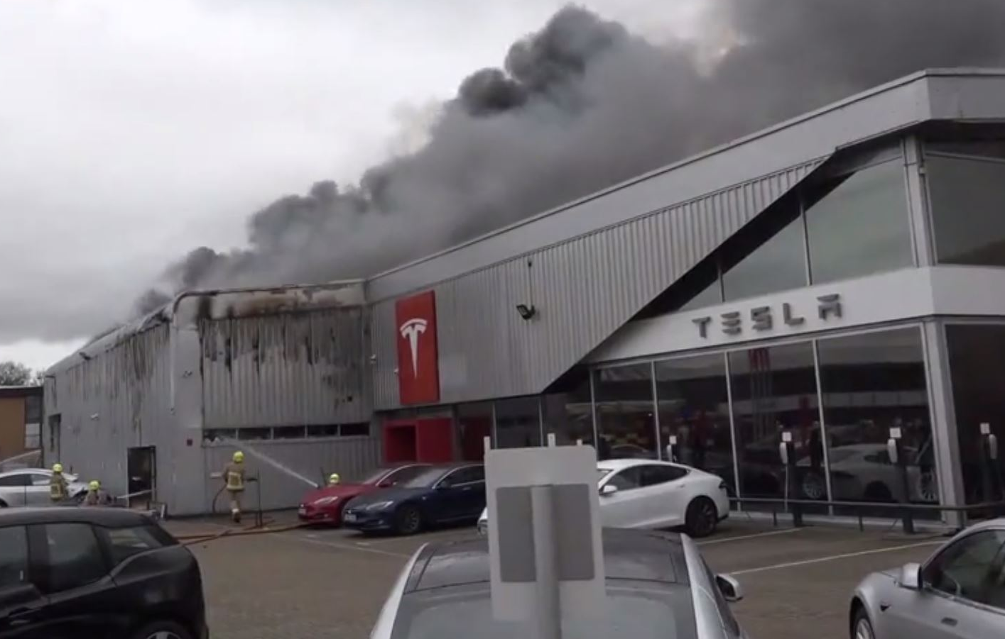
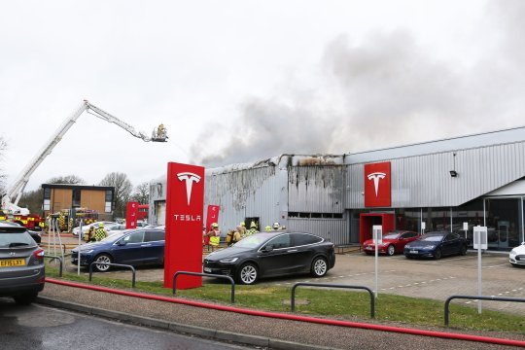
What if …
Theme copy | Theme Copy | Theme Copy
Notes:
Cecil Story #1, Blake Story #4

Slide 11
One Year Later, Your Grand Re-Opening!
Who is the staff?
What is the layout? Security?
What new technology does it have?
What new compliant and customer driven processes do you implement?
What is the philosophy of the store?
Theme copy | Theme Copy | Theme Copy

Slide 12
Why are you waiting for a fire?
Theme copy | Theme Copy | Theme Copy

Slide 13

Thank you!
M. Ritchey Wheeler
President
Ritch.Wheeler@EagleTrainingAcademy.com
214.695.2567
Theme copy | Theme Copy | Theme Copy

Slide 14
Theme copy | Theme Copy | Theme Copy
Thank You For Your Time

