Slide 1




Association of Dealer Compliance Officers
PROFESSIONAL COMPLIANCE EDUCATION WEBINARS
Prioritizing Cyber-IT Security Defenses for Your Dealership
In Alliance with Sensitive Data Protect, LLC
March 24, 2022

Slide 2




Prioritizing Cyber-IT Security Defenses for Your Dealership
ADCO and Sensitive Data Protect, LLC Including Wilson Elser Team Up to Discuss Where Your Cyber-IT Security Process Should Start
Panelists
Peter Leger
CEO/Co-Founder
Sensitive Data Protect, llc
Linda Robinson
CEO/Founder ADCO
Rick Bortnick
Of Counsel
Wilson Elser
Jim Lawrence
COO/Co-Founder Sensitive Data Protect, llc
Association of Dealer Compliance Officers Presentation © 2022

Slide 3
Agenda
Introduction
  Dealership Cyber- IT Security Challenges for 2022
Where to Start the Critical Cyber-IT Security Prioritization Process
  Cyber-IT Security Risk Assessments
Dealers Rarely Do Independent Tests For Cyber-IT Security Weaknesses and Compliance Issues
  You Can't Guess Anymore
Over 85% of Data Breaches are Caused by Lack of Employee Cyber-IT Security Training
  Dealership Employees are the Weak Link in a Dealership Cyber-IT Security Strategy
Here Are the Top 10 Best-in-Class Cyber-IT Security Tools, Systems and Standards
  Where Does Your Dealership Rank
6. Why Your Dealership Needs Cyber Security Insurance
  Would You Ignore Insurance Coverage to Protect Your Dealership From Fire, OSHA, Product Liability Claims
7. Concluding Comments
  Importance of a Good Faith Compliance Effort
Association of Dealer Compliance Officers Presentation © 2022

Slide 4
Dealership Cyber- IT Security Challenges for 2022
BEING PREPARED IN A DYNAMIC CYBER WORLD
PROTECTING YOUR DEALERSHIP AND DATA HAS NEVER BEEN MORE IMPORTANT
INDEPENDENT CYBER SECURITY RESEARCH PAINTS A CHALLENGING PICTURE FOR DEALERSHIP MANAGEMENT
CDK GLOBAL 2021 — STATE OF CYBER SECURITY IN THE DEALERSHIP
VERIZON 2021 — DATA BREACH INVESTIGATIONS REPORT
BARRACUDA 2021---BUSINESS EMAIL COMPROMISES
85% OF DEALERS ARE WORRIED MORE THAN EVER ABOUT CYBER-IT SECURITY THREATS AND DATA BREACHES
FBI STATS SHOW RANSOMWARE ATTACKS OCCUR EVERY 2 SECONDS - APPEARS IN 10% OF CYBER-IT DATA BREACHES
WIDESPREAD SENSE OF URGENCY TO IMPLEMENT CYBERSECURITY AND CONCERN THAT COMPLEXITY OF SOLUTIONS FAR EXCEED DEALER MANAGEMENT’S CONFIDENCE TO COMPLIANTLY ACHIEVE
NEW FTC REQUIREMENTS FROM EXPANDED GLBA SAFEGUARD RULE’S INFORMATION SECURITY PROGRAM INCREASE COMPLIANCE MANAGEMENT DIFFICULTY

Slide 5
REAL LIFE EXAMPLE OF A DEALER GROUP
DATA BREACH AND RANSOMWARE ATTACK 2021
DEALER GROUP—20 ROOFTOPS
DATA BREACH AT 1 BRAND ROOFTOP
HACKERS GAINED ENTRY THROUGH A PHISHING ATTACK
HR DIRECTOR WAS PHISHED AND HACKERS GAINED ACCESS TO UNENCRYPTED CUSTOMER CREDIT APPLICATION FILES STORED IN TEMPORARY BACK- UP FILES
RANSOMWARE DEMAND FOR $2MILLION OR HACKERS WOULD PUBLICALLY DISCLOSE THE DEALERSHIP BREACH,RECORDS AND KEEP SYSTEMS DOWN
Size of the breach—1,000+ customer credit application records
Time it took to identify and contain the data breach—10 days
Effective management of detection and escalation costs—Ransomware Payout $1M+
Effective management of post data breach costs—Legal Fees, Forensic Audits, Business Disruption--$750K
Unexpected loss of customers following a data breach????
CUSTOMER CLASS ACTION SUITS?????
LUCKILY, THE DEALER GROUP HAD CYBER SECURITY INSURANCE COVERAGE OF $5M with a $75,000 DEDUCTIBLE
Association of Dealer Compliance Officers Presentation © 2022

Slide 6
Where to Start the Cyber-IT Security Prioritization Process… CYBER-IT SECURITY RISK ASSESSMENTS
Step 1: Assessment Phase
YOU NEED TO UNDERSTAND YOUR DEALERSHIP’S RISK PROFILE
Preliminary Cyber-IT Security Assessment of Dealer’s Facing URLs and External IPs
Quick 10-Question Cyber-IT Security Risk Profile Questionnaire for Dealers
ONCE YOU ASSESS YOUR CYBER-IT SECURITY RISK PROFILE IS HIGH OR MEDIUM OR LOW?????
YOU CAN THEN TAILOR THE NEXT KEY PHASES OF YOUR CYBER-IT SECURITY DEFENSES PROGRAM
Association of Dealer Compliance Officers Presentation © 2022

Slide 7
Dealers Rarely Do INDEPENDENT Tests/Scans For Cyber-IT Security Weaknesses to Uncover Compliance Issues
Step 2: Testing Phase
NEED TO UNDERSTAND THE FACTS VS. GUESSING
IT System and Database Scanning of the Following:
  External Facing (Outside Firewall) IP Addresses by an Authorized Scanning Vendor (ASV) For Payment Card Industry (PCI) Compliance and;
  Internal IP addresses and Employee Computing Endpoints and Email Systems (Inside Firewall) to Identify Cybersecurity, Personally Identifiable Information (PII) and Data Privacy and Regulatory Compliance Risks & Weaknesses
DMS Scans to Identify Storage of Unencrypted Credit Card Data — Many dealers store electronic records of credit card data in different forms — our empirical tests showed 95%+
Association of Dealer Compliance Officers Presentation © 2022

Slide 8
Over 85% of Data Breaches Are Caused by Lack of Employee Cyber-IT Security Training
Step 3: Training Phase
NEED TO UNDERSTAND HOW TO IMPROVE EMPLOYEE CYBER-IT SECURITY AWARENESS
EMPLOYEE ERROR LEADS TO 94% OF MALWARE AND RANSOMWARE ATTACKS FROM PHISHING/SMISHING AND SOCIAL ENGINEERING
Cyber-IT Security Awareness Training For Employees
REDUCES CYBER-IT RISKS BY 75%+
• IT Security Awareness
• Phishing Defense
• Phishing Simulation
• Ransomware Defense
• Payment Card Industry (PCI) Compliance
• Personally Identifiable Information (PII) Compliance
• State Consumer Data Privacy Protection Compliance
IMPLEMENTED ON AN eLEARNING Management System INTEGRATED WITH YOUR DMS PAYROLL SYSTEMS
Association of Dealer Compliance Officers Presentation © 2022

Slide 9
Here Are the Top 10 Best-in-Class Cyber-IT Security Tools, Systems and Standards
Step 4: Selecting Security Tools, Systems and Standards
UNDERSTANDING HOW TO INVEST TO QUICKLY REMEDIATE KNOWN/FOUND WEAKNESSES
Top 10 Questions to Answer
Base Standards
Are Personally Identifiable Information (PII), Payment Card Industry (PCI), Social Security Number (SSN), Confidential Financial Information (CFI), Non-Public Information (NPI), and Biometric Information encrypted and protected from unlawful access?
Does you Dealership require third parties you share personally identifiable or confidential information with to indemnify you for legal liability against the fault or negligence of the 3rd party software provider?
Does Your Dealership Have Endpoint Protection and IT Network Monitoring Tools in Place?
Is your Dealer Group Payment Card Industry (PCI) compliant with applicable data security standards (12 DSS V4.0) issued by the PCI Security Council and Include Completion of Required Self-Assessment Questionnaire (SAQ)?
Does your Dealer Group perform independent testing on 100% of your external and internal IP addresses for vulnerability weaknesses, including your DMS?
Ransomware Supplemental Standards
Does your Dealership Have Email protection to pre-screen E-mails for potentially malicious attachments and links?
Is Multi-factor Authentication (MFA) in place to protect privileged user accounts and protect Remote Access To the DMS?
Is there automated restoration of IT systems prior to a ransomware attack with Password Protection Tools and Protocols?
Is Monthly phishing and simulation training conducted with staff using an eLMS integrated into payroll systems to track usage and adherence?
Is Ransomware Defense training implemented for all staff and managers on a quarterly basis?
Association of Dealer Compliance Officers Presentation © 2022

Slide 10
Why Your Dealership Needs
Cyber Security Insurance
Key Question For Dealer Group Management
Isn’t cyber insurance covered under my General Property & Casualty insurance plan?
The short answer is, No.
While liability coverage for data breach and privacy claims has been found in limited instances through General Liability, Commercial Crime and some D&O policies, these forms of coverage are not intended to respond to the cybersecurity threats posed in today’s 24/7 consumer information protection environment.
COSTS ASSOCIATED WITH A CYBER-IT SECURITY DATA BREACH
Summary US highlights from Ponemon Institute LLC and IBM- 2021 (For all companies/industries including auto dealers and automotive retail):
Average total cost of a data breach - $2M TO $7.9M DEPENDING ON COMPANY SIZE
Average cost per lost or stolen record - $273
Likelihood of a recurring material breach over the next two years — 47.9%
Average Notification costs - $740,000 and average post-data breach costs - $1.8M
Association of Dealer Compliance Officers Presentation © 2022

Slide 11
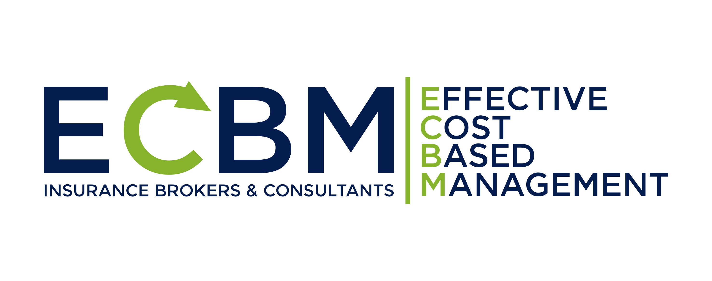




WHAT CYBER SECURITY INSURANCE COVERS
AND WHAT THE DEALERSHIP P & C POLICIES DON’T COVER
Third Party Liability
TECHNOLOGY ERRORS AND OMISSIONS LIABILITY
MULTIMEDIA AND INTELLECTUAL PROPERTY LIABILITY
Cyber Privacy
SECURITY AND PRIVACY LIABILITY
PRIVACY REGULATORY DEFENSE AND PENALTIES
EVENT SUPPORT & NOTIFICATION EXPENSES
Cyber First Party
DEPENDENT BUSINESS INCOME LOSS
FORENSIC ACCOUNTING COSTS & LEGAL COSTS
PHYSICAL DAMAGE, PHYSICAL LOSS AND DEBRIS REMOVAL
Cyber Crime
ELECTRONIC THEFT, COMPUTER FRAUD AND TELECOMMUNICATIONS FRAUD
SOCIAL ENGINEERING FRAUD
INVOICE MANIPULATION
TAILORED CYBER SECURITY INSURANCE FOR AUTO DEALERS
OUR INSURANCE & LEGAL PARTNERS
SENSITIVE DATA PROTECT LLC CYBER-IT SECURITY MANAGED SERVICES PROVIDER
FOR DEALERS
Association of Dealer Compliance Officers Presentation © 2022

Slide 12
Would You Ignore Insurance that Protects You from Fire, Flood, or Product Liability Claims?
LESS THAN 5% OF DEALERSHIPS HAD CYBER SECURITY INSURANCE 5 YEARS AGO
>DEALERSHIPS NOW RECOGNIZE THE NEED IN 2022
DEALERS WANT ASSISTANCE FROM INDEPENDENT EXPERTS TO OBTAIN THE RIGHT CYBER SECURITY INSURANCE
KEY STEPS IN OBTAINING AFFORDABLE CYBER INSURANCE
HAVE AN INSURANCE BROKER WHO IS AN EXPERT IN CYBER-IT SECURITY ASSIST YOU IN THE PROCESS ESPECIALLY COMPLETING THE COMPLEX APPLICATION(45+ QUESTIONS)
  Beware of the fine print and coverage exclusions
IMPLEMENT BEST-IN-CLASS CYBER-IT SECURITY TOOLS, SYSTEMS AND STANDARDS
  Can reduce cyber security premium costs/deductibles by over 50% and many cases enable dealerships to avoid being declined insurance
Association of Dealer Compliance Officers Presentation © 2022

Slide 13
Dealer’s Best-In-Class Cyber-IT Security Defenses
ADDRESSES 80%+ OF FTC’S SAFEGUARD RULE ISP
Email Protection
Application Security
Testing/Scanning
Network Security
Testing/Scanning
PII Data Protection
Testing /Scanning
Employee Training
Cyber Insurance Coverage
Association of Dealer Compliance Officers Presentation © 2022

Slide 14
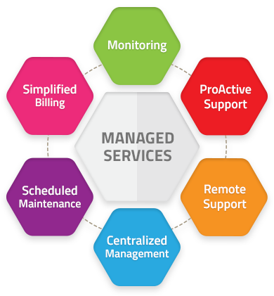
The Benefits of SDP’S Managed Services
Understanding cyber-IT threats and trends in the automotive retail industry
Dedicated cyber-IT security technology stack for auto dealers
Ability to properly deploy, manage, and support the best-in-class systems, tools and standards for any size dealer group
Affordable a la carte or bundled pricing for solutions & services
Trusted advisor mentality
Association of Dealer Compliance Officers Presentation © 2022

Slide 15
CONCLUDING COMMENTS
IT IS NOT A QUESTION OF IF YOUR DEALERSHIP WILL SUFFER A DATA BREACH
BUT WHEN
WHAT WE COVERED TODAY OUTLINES A “GOOD FAITH COMPLIANCE EFFORT” FOR A PROVEN RISK MANAGEMENT PROGRAM VALUED AND REWARDED BY CYBER SECURITY INSURERS THAT YOU NEED IN TODAY’S DYNAMIC CYBER WORLD
YOUR DEALERSHIP BRAND AND REPUTATION IS ON THE LINE
PRIORITIZING NEXT STEPS IN YOUR CYBER-IT DEFENSES PROGAMS WILL TAKE MORE THAN GOOD LUCK
SPECIAL OFFER TO WEBINAR PARTCIPANTS:
  SDP will provide a free cyber-IT risk assessment to the first 25 dealers who contact us--$1,000 value
Association of Dealer Compliance Officers Presentation © 2022

Slide 16

THE ADCO AND SDP TEAMS ARE READY TO ANSWER ANY QUESTIONS ABOUT TODAY’S WEBINAR
HOW TO REACH US
jim.lawrence@sdpcompliance.com
(503) 318-3621
https://sdpcompliance.com/index.php/contact-us/
linda.robertson@adcocommunity.com
(682) 325-4381
https://www.adcocommunity.com/contact
richard.bortnick@wilsonelser.com
(610) 203-1456
https://www.wilsonelser.com/contact
THANK YOU FOR ATTENDING

