Slide 1
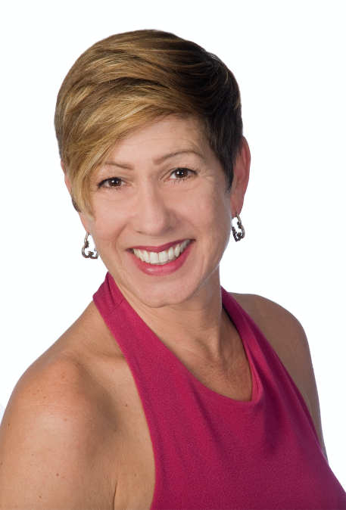


Presenter
With 22 years in the automotive industry, Sandy is passionate about protecting profits through compliance, programs, and training.
She opened IAHR in 2017 and in 2019 received Tampa HR’s award for HR Consultant of the year. Sandy is a processed based problem solver who believes deeply in offering exemplary customer service to her clients, earning their loyalty and trust.
Sandy holds SPHR & SHRM-SCP certifications as well as ADCO’s Dealership Compliance Officer certification and is honored to be on the Association of Dealership Compliance Officers Advisory Board.
Sandy is also a Certified Diversity, Equity & Inclusion practitioner through The People Company’s Inclusion Institute. It isn’t all work for Sandy! She is the proud mother of a beautiful daughter, Arianna, who is the light of Sandy’s life. Sandy is also an avid salsa dancer—in her spare time (when the pandemic is over), you can find Sandy on the dance floor!
Sandy Zannino, SPHR, SHRM-SCP
Founder, President
Innovative Auto HR, LLC
941.306.8310
sandy@innovativeautohr.com
ASSOCIATION
OF DEALERSHIP
COMPLIANCE OFFICERS

Slide 2
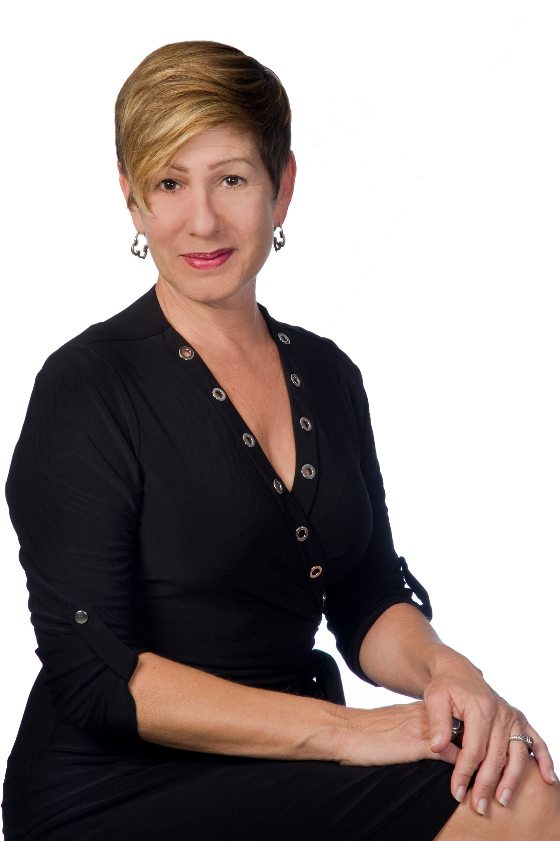

2021—It’s Still a Covid-19 World
Sandy Zannino
Founder
941.306.8310
sandy@innovativeautohr.com
www.innovativeautohr.com

Slide 3
Disclaimer
The contents of this presentation are intended to convey general information only and not to provide legal advice or opinions. The information provided herein should not be construed as, and should not be relied upon, for legal advice in any particular circumstance or fact situation. No action should be taken in reliance on the information contained herein and we disclaim all liability in respect to actions taken or not taken based on any or all of the contents of this site to the fullest extent permitted by law. Your attorney should be contacted for advice on specific legal issues.

Slide 4


“The Future ain’t what it used to be” Yogi Berra

Slide 5
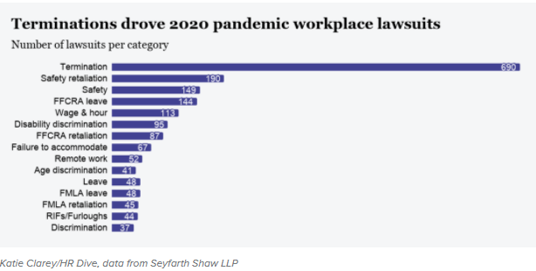
2020 Covid-19 Lawsuits

Slide 6
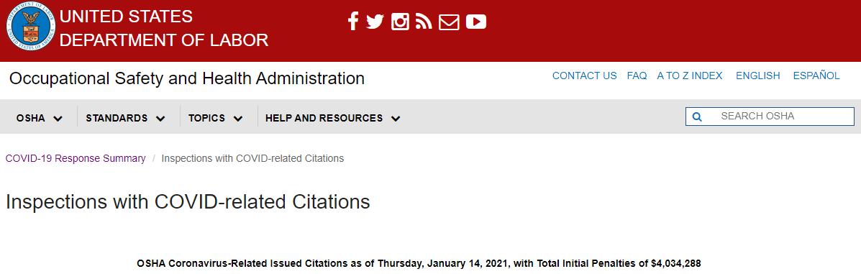
January 14, 2021
$4,034,288

Slide 7
Consolidated Appropriations Act/”The Relief Bill”
December 27, 2020
FFCRA paid leaves related to Covid-19 was no longer mandated as of Dec 31,2020
  E-Sick Pay
  E-FMLA
  100% Reimbursable through payroll tax deposit reductions
The Relief Bill allowed for employers to do two things related to above paid leaves
To recover costs of providing required FFCRA leave in 2020
To VOLUNTARILY provide paid E-sick & E-FMLA and be reimbursed
Through 1st Quarter of 2021
All of the recordkeeping, eligibility rules & coordination with regular FMLA still apply.

Slide 8
January 29, 2021
OSHA COVID Guidance Issued
Much of the guidance is the same
Emergency Temporary Standard expected by March 15, 2021
  More force & power than guidelines
  OSHA has been relying on General Duty Clause

Slide 9
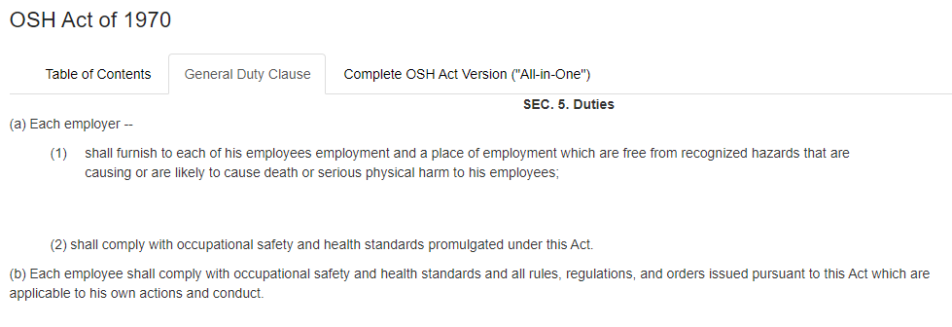
General Duty Clause

Slide 10
January 29, 2021
OSHA COVID Guidance Issued
Much of the guidance is the same
Emergency Temporary Standard expected by March 15, 2021
  More force & power than guidelines
  Expected that the ETS will draw from the Jan 29 Guidance
Check your State OSHA
  Michigan, Virginia, California, Oregon, Washington
  Virginia – Now permanent rule
What is different about the new OSHA Guidelines? https://www.osha.gov/coronavirus/safework
Employers should provide all workers with face coverings (unless their work requires a respirator) 2 layers and NOT feature exhalation valves or vents.
Continued quarantine directives for close contact with positive person.
Employers are directed to minimize the effect of quarantines by implementing non-punitive policies and encouraged to provide sick leave

Slide 11
January 29, 2021
OSHA COVID Guidance Issued
What is different Continued
Employers are directed to assign a workplace coordinator
  This person would be responsible for dealing with Covid-19 related issues as they arise
Employers under 500 EE’s encouraged to provide FFCRA paid leave – March 31st
Hazard Assessment
  Must include workers (and their representatives—ASK ADAM what that means)
  Identify where and how worked might be exposed to COVID-19 at work

Slide 12
Practical Suggestions
Continue with all the protocols you have been doing in customer & employee areas—masks and other PPE, social distancing, ventilation when possible, eliminating shared spaces (phones computers etc.) signs etc. Reinforce all these policies
Encourage employees to stay home if sick.
Continue monitoring and following CDC & OSHA guidelines
Understand when to record a case in the 300 logs
Remember coordination with workers compensation
Understand when and how to REPORT to OSHA
  Within 30 days
  8 hours – Fatality
  24 hours – inpatient hospitalization

Slide 13
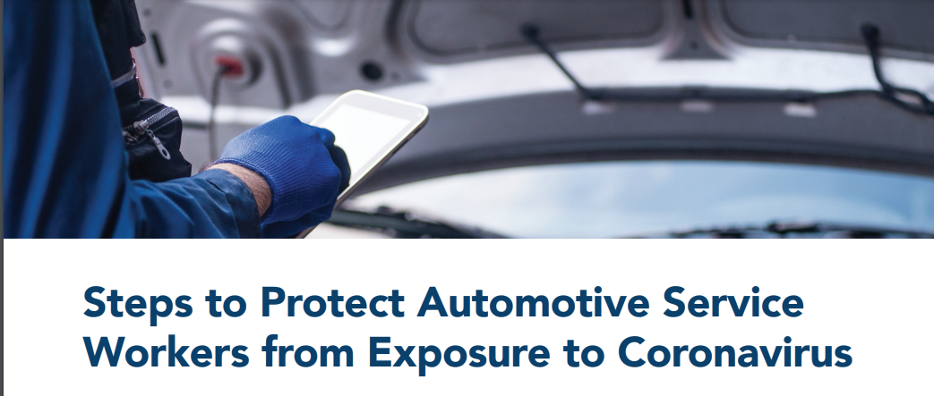
Practical Suggestions
https://www.osha.gov/sites/default/files/publications/OSHA4070.pdf
Pick up/Drop off service
Limit # of people in waiting areas
No touch payment options
Cover seats & Sanitize after service

Slide 14





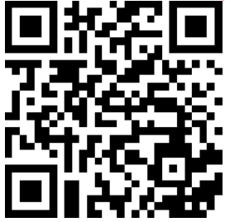

COMPLYNET’S
COVID-19 RESOURCE CENTER
Available at: https://www.complynet.com/covid-19-coronavirus/
Follow us on Linked-In:

