Slide 1
Presenter
The Association of Dealership Compliance Officers (ADCO) is an association of automobile dealer compliance officers committed to identifying and carrying out compliance best practices that mitigate dealers’ exposure and gain the trust of the buying public.
ADCO was developed by, and led by, Linda J. Roberson. Linda brings to the association more than two decades of high level, hands-on, experience in all phases of regulatory compliance in the healthcare, insurance, and franchised automobile dealer industries.
With direct exposure to both policy development and its real-world applications, Linda’s approach to satisfying the requisites of an in-store CMS is comprehensive in its scope, but highly practical, cost-effective, and adaptable in its applications. Under her direction, ADCO will provide operational structure, serve as an educational resource, and as a Best Practices forum for in-store corporate compliance officers in the franchise, used car, buy here pay here, RV, powersports and commercial dealerships.
The ADCO Community is for industry compliance professionals. Dealership compliance officers are charged with tremendous responsibilities. They create and manage the dealerships compliance and ethics program – under the oversight of the board of directors or the dealer principle - provide training, assist with change management processes, develop and monitor quality assurance and compliance best practices.
For the first generation of auto industry compliance officers springing up in dealerships across the land, there may be few peers available and scant guidelines. Many compliance professionals are the first in their role for that particular dealership. The ADCO community will provide support that’s tailored to dealership cultures and pinpointed to the issues and incentives that dealerships face.
Together we will develop best practices, provide support and win recognition for the professional achievements of compliance officers. This will provide the platform compliance officers need for exchanging experiences, bouncing ideas off each other, and developing best practices to guide their dealerships’ responses.
Linda J. Robertson, SPHR
Founder, Executive Director
Association of Dealership Compliance Officers
817.428.2434 #954
Linda.Robertson@adcocommunity.com
ASSOCIATION
OF DEALERSHIP
COMPLIANCE OFFICERS

Slide 2
Why Behavioral Interviewing?
Association of Dealership Compliance Officers

Slide 3
Why a Behavioral Interview?
Why Behavioral Interviewing?
Preparing for the Interview
The Interview
Best Practices
After the Interview

Slide 4
Recruitment Process Component
Onboarding
05
.
Decision
04
Interview
03
Selection
02
Application
.
01

Slide 5
Why Interview?
01
Meet the Candidate
02
Interact
03
Determine Skills
The most widely used types of interviewing are:
The telephone prescreen interview.
The direct one-on-one interview, which can take a behavioral, competency-based or situational approach.
The panel interview.
Virtual interview.
04
Culture Fit
Notes:
Behavioral and competency-based approaches. Behavioral and competency-based interviewing both aim to discover how the interviewee performed in specific situations. The logic is based on the principle that past performance predicts future behavior; how the applicant behaved in the past indicates how he or she will behave in the future.
In a behavioral or a competency-based interview, the interviewer's questions are designed to determine if the applicant possesses certain attributes or skills. Instead of asking how the applicant would handle a hypothetical situation, the interviewer asks the applicant how he or she did, in fact, handle a particular situation in the past. Behavioral and competency-based interview questions tend to be pointed, probing and specific.

Slide 6
Behavior-Based Interviews?
Psychological scientists who study human behavior agree that past behavior is a useful marker for future behavior. But only under certain specific conditions: High-frequency, habitual behaviors are more predictive than infrequent behaviors. Predictions work best over short time intervals. The interviewer's questions are designed to determine if the applicant possesses certain attributes or skills at that period of time. Instead of asking how the applicant would handle a hypothetical situation, the interviewer asks the applicant how he or she did, in fact, handle a particular situation in the past.
"The Best Predictor of Future Behavior Is … Past Behavior ...
www.psychologytoday.com › blog › witness › the-best-...
Jan 3, 2013
Social-cognitive theorists build on well-established concepts of learning and cognition. They tend to believe that the best way to predict someone's behavior in a given situation is to observe that person's behavior in similar situations. The situational approach is an interview technique that gives the candidate a hypothetical scenario or event and focuses on his or her past experiences, behaviors, knowledge, skills and abilities by asking the candidate to provide specific examples of how the candidate would respond given the situation described.
Competency-based interviews (also known as structured, behavioral or situational interviews) are designed to test one or more skills or competencies. The interviewer has a list of set questions, each focusing on a specific skill, and interviewees answers will be compared against pre-determined criteria and marked accordingly. Competency-based interviewing can give the interviewer a sense of an applicant's job performance and attitude toward work.
Notes:
Popular with recruiters because they can easily compare lots of candidates, behavioral and competency-based interviews take existing experience as an indicator of future performance.
You should be aware that, in the HR literature, some sources use “behavioral interviews” and “competency-based interviews” synonymously. Others distinguish between the two. This presentation maintains the original source’s interpretation, so you will see both representations.

Slide 7
Job Descriptions tell the incumbent and the HR professional the job specifications and clarify the minimum requirements to qualify for the job and essential responsibilities – important keys to HR functions in the selection process.
Desired Profile
Determine the success factors for this position.
Measure the success factors.
Ethical behavior and decision-making skills
Courage
Expectations of the Job
It is important to set clear performance expectations.
Be specific and clear as to what the expectations are and how you will measure them.
The overall purpose of having performance expectations is to move toward a specific company goal and create workplace accountability from one employee to another.
Compliance and ethical expectations
Authority to do the job
Training and resources
Qualifications
According to the job specifications—the most important qualities, experiences, education and characteristics that a successful candidate would possess.
Skills Required
Skills at drawing insights from data
Excellent time management & organizational skills
Distinctive problem solving, analytical & strategic capabilities
Soft and hard skill sets
Influencer, champion

Slide 8
Preparing for the Interview
...The behavioral interviewing technique can take a great deal of effort and planning before an interview can ever take place.
Schedule a planning meeting with the appropriate attendees, such as co-workers, an indirect but interested manager or internal customers of the position.
Decide on the applicant screening questions for the telephone screens.
Decide the type of interview venue that will be used.
Create/select specific questions to determine whether an applicant possesses the critical success factors.
Determine who will interview the candidate.
Plan the interview and the follow-up process.
Review beforehand the job description and the resume of each candidate to be interviewed.
Notes:
In the behavioral approach—a traditional technique for assessing a candidate's suitability for a position—the purpose is to review the candidate's experience, personal attributes and job-related skills.
The competency-based approach focuses specifically on skills needed for the position; job-related skills constitute the criteria against which applicants are measured.

Slide 9
Behavior-Based Questions
The premise behind behavioral interviewing is that the most accurate predictor of future performance is past performance in similar situations.
Instead of asking how the applicant would handle a hypothetical situation, the interviewer asks the applicant how he or she did, in fact, handle a particular situation in the past.
Open-ended Questions vs Closed-ended Questions
Describe a situation in which you were able to use persuasion to successfully convince someone to see things your way.
Describe a time when you were faced with a stressful situation that demonstrated your coping skills.
Give me a specific example of a time when you used good judgment and logic in solving a problem.
Give me an example of a time when you set a goal and were able to achieve it.
A Guide to Behavioral Interviewing SHRM.org

Slide 10
Behavior-Based Questions
Behavioral and competency-based interview questions tend to be pointed, probing and specific.
Tell me about a time when you had to use your presentation skills to influence someone's opinion.
Give me a specific example of a time when you had to conform to a policy with which you did not agree.
If answers seem to be thin on detail, the interviewer can ask follow-up questions:
What exactly did you do?
What was your specific role in this?
What challenges did you come across?
Why precisely did you do that?
Why exactly did you make that decision?

Slide 11
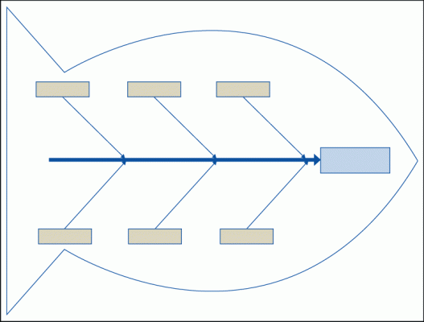
Behavior-Based Questions
Request specific information
Question
Completed Answer
Question
Probe for additional information

Slide 12
Behavior-Based Questions
Ask the applicant how they handled different work situations in the past. Their answers can provide a glimpse into their personality, abilities and skills.
Tell me about a time when you had to encourage others to contribute ideas or opinions. How did you get everyone to contribute? What was the end result?
Tell me about a situation in which your spoken communication skills made a difference in the outcome. How did you feel? What did you learn?
Tell me about a situation when you had to persuade others to accept your point of view when they thought you were wrong. How did you prepare? What was your approach? How did they react? What was the outcome?

Slide 13
A Situational Approach
This type of interview reveals how an applicant thinks and how he or she would react in a particular situation.
The situational approach is an interview technique that gives the candidate a hypothetical scenario or event and focuses on his or her past experiences, behaviors, knowledge, skills and abilities by asking the candidate to provide specific examples of how the candidate would respond given the situation described.
You have been hired as the HR director in a 300-employee company and are struggling to perform the necessary HR administrative work by yourself. Your manager, the CFO, tells you that you need to be more strategic. How would you handle this situation?
You learn that a former co-worker at your last company is applying for an accounting position with your company. You have heard that this person was terminated after admitting to embezzling funds from the company but that no criminal charge was made. You are not in HR. What, if anything, would you do?

Slide 14
Competency-Based Interview
These types of interviews allow potential employers to identify the “key competencies” of a potential employee or the specific qualities required to be successful in a position. Determine key competencies related to the position.
Interviewers will use competency-based questions to ask applicants about specific examples in which they demonstrated a specific skill or quality and compare the answer against pre-determined criteria.
Teamwork
Responsibility
Problem solving
Organization
Commitment to development
Decision making
Openness to change
Communication
Leadership
Commercial awareness
Customer service
Conflict resolution
Career motivation
Trustworthiness & Ethics
Results driven
Safety conscious
Notes:
A competency-based interview may also be referred to as a behavioral interview or a criterion-based interview.

Slide 15
Competency-Based Interview
These types of interviews allow potential employers to identify the “key competencies” (related to this position) of a potential employee, or the specific qualities required to be successful in a position.”
COMPETENCY-BASED INTERVIEW QUESTION – PROBLEM SOLVING + CONFLICT RESOLUTION
Q. Describe a time when you solved a difficult problem at work.
SITUATION – While at work, I noticed two work colleagues had not been getting on for some time. So, although the situation hadn’t yet impacted the company’s performance, I was concerned things could escalate unless someone stepped in to resolve the problem.
TASK – I felt someone needed to get hold of the situation with a view to resolving it amicably and as quickly as possible. It was my task to get the two people together, find out what the issue was with a view to sorting the situation out so we could all move forward as a team.
ACTION – I initially sat down in private with each person individually to ask them what was going on. So, I managed to gather some useful information, which led me to believe the problem was all down to a simple miscommunication. It transpired that one of them felt the other person had not been doing their job properly, which resulted in the other person having an increased workload. Therefore, I got them both together in a private room and asked them to talk sensibly about it whilst I facilitated the discussion. Although it was uncomfortable at times, they both were relieved to get the situation resolved.
RESULT – The end result was that both work colleagues cleared the air, shook hands and agreed to talk about things openly in the future, if a similar situation arose again.
How2Becom.com
Notes:
A competency-based interview may also be referred to as a behavioral interview or a criterion-based interview key competencies

Slide 16
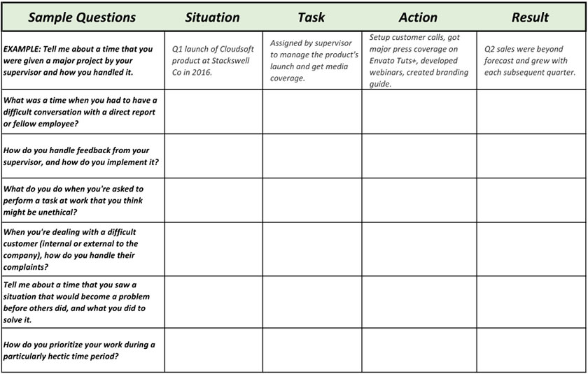
Situation: Describe the context in which the situation you are discussing took place.
Task: Explain the task you were responsible for in the situation.
Action: Describe what action you took to resolve an issue or improve a situation
.
Result: Provide details of the result that came about due to the action you took.
How to Succeed in Behavioral Interviews With the STAR Matrix
by Andrew Childress 13 Dec 2017

Slide 17
Behavioral Interview
Best Practices
Have an operational knowledge of the position, skills, environment and expectations
Prepare questions in advance…
Practice, practice, practice
Be consistent with each candidate
Prepare the interviewee
Provide information about the interview.
“I am going to ask you questions about work situations or projects that you have completed in your past employment. You may say something that can provide a better understanding of your skills. I may ask you to provide more detail.”
Interview process
Confirm the interviewee has read the job description
Create a comfortable environment for the interview
Provide information about the dealership
Answer questions
What are the follow-up expectations or timetable?

Slide 18
Behavioral Interview
Best Practices
Address possible biases
Confirmation bias – make snap decisions based on perceived truths and then spend the rest of the time, subconsciously or not, trying to justify our bias. This is when we ask irrelevant questions, trying to elicit answers that support our initial assumption about the candidate.
Affect heuristics – judging someone’s suitability for a position based on superficial factors that have no sway in how they would carry out the task at hand.
Expectation anchor – when we allow ourselves to anchor onto one certain piece of information about a candidate and use it to help us make decisions.
Halo effect – recruiter forgoes proper investigation of a candidate’s background, choosing instead to focus too heavily on one positive aspect of a candidate.
https://harver.com/blog/hiring-biases/

Slide 19
Behavioral Interview
Best Practices
Address possible personal and dealership biases
Horn effect – we believe that if the candidate is bad at A, they’ll be bad at B. If we let this cloud our judgement, more often than not it impacts our hiring decision.
Overconfidence bias – we allow our subjective perception of confidence to cloud our objectivity and tend to rely on so-called intuition
Similarity attraction bias – we are more inclined to hire candidates we view as being like us or having similar traits or characteristics as us, even when those things aren’t correlated with on-the-job performance.
https://harver.com/blog/hiring-biases/

Slide 20
After the Interview – Setup to Win
Advertisements
Extend Job Offer & On-Boarding
Review Applicants
Selection Process
Interview
.
Panel or Manager Interview

Slide 21
Thanks for watching
Email Address:
Linda.Robertson@
ADCOcommunity.com
Contact Number:
817.428.2434 #954
Web:
Adcocommunity.com

